Slide 1

Shower Water Monitor
MTE390 Training (1)

Slide 2
Under Supervision: Eng. Ahmed Ramadan
Eng. Abdelrahman Omar

Slide 3







Our Team
Ahmed Ismail
Alaa Nasser
Ahmed Elzehery
Mechanical Designer 800136431
Software Engineer 800136619
Hardware Engineer 800136490
Designed the box, made an assembly for every part, and supervised the process
Implemented drivers for every layer of the project, wrote the main code, and designed a simulation.
Designed PCB Hardware, collected hardware components, and tested the circuit.

Slide 4
Agenda Style
01
ABSTRACT
02
WORKING PRINCIPLE
03
HARDWARE
04
MECHANICAL DESIGN
05
SOFTWARE
06
FINAL PRODUCT

Slide 5
1.
Abstract

Slide 6

Water Reduction
Reasons
Us like individuals
After thinking for a long time, we found that most of wasted water when we use the shower.
Egypt as Country
Furthermore, Egypt has a water poverty problem and the person's intake of water is less than the average, so we decided to give a little help to make people aware of our high-water usage.
As well as we found that different shower heads can use anywhere from 9.5 liters per minute to less than 6 liters per minute.

Slide 7
2.
Working
Principle

Slide 8
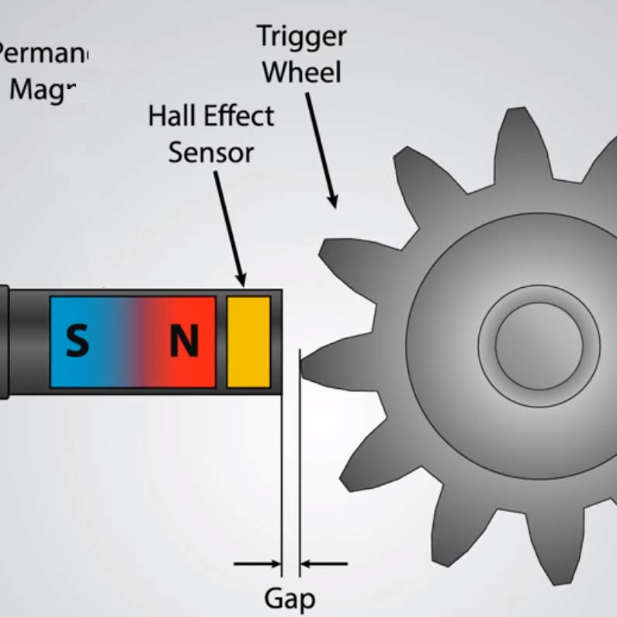
Working Principle
Our device depends on the signal that is generated from the Water Flow Meter Sensor (YF-S201). As this sensor generate the pulses which is directly proportional to the volume of the water
We receive the pulses from the sensor through our PCB then we transmit these pulses to our AVR Processor which process this signal and produce a number which indicates the total volume of the water after that we do some mathematical calculation to get the flow rate and cost of water.

Slide 9
3.
Hardware

Slide 10



Hardware
The overall hardware components that is collected on PCB board for portability
Flow Sensor
ATmega16
A voltage difference is induced in the conductor due to the rotation of the rotor. This induced voltage difference is transverse to the electric current
Flow
Sensor
The AVR processor takes the signal generated from the sensor and gives a proper number for further calculations
ATmega16
Charging Circuit
Charging Circuit
LCD
LCD
This circuit make our device portable and industrial as it make it rechargeable and dependent on its own power
It presents the results that is generated from the ATmega16 to be visible for the user

Slide 11
Hardware
The overall hardware components that is collected on PCB board for portability
Flow Sensor
ATmega16
A voltage difference is induced in the conductor due to the rotation of the rotor. This induced voltage difference is transverse to the electric current
Flow
Sensor
The AVR processor takes the signal generated from the sensor and gives a proper number for further calculations
ATmega16
Charging Circuit
Charging Circuit
LCD
LCD
This circuit make our device portable and industrial as it make it rechargeable and dependent on its own power
It presents the results that is generated from the ATmega16 to be visible for the user

Slide 12
Hardware
The overall hardware components that is collected on PCB board for portability
Flow Sensor
ATmega16
A voltage difference is induced in the conductor due to the rotation of the rotor. This induced voltage difference is transverse to the electric current
Flow
Sensor
The AVR processor takes the signal generated from the sensor and gives a proper number for further calculations
ATmega16
Charging Circuit
Charging Circuit
LCD
LCD
This circuit make our device portable and industrial as it make it rechargeable and dependent on its own power
It presents the results that is generated from the ATmega16 to be visible for the user

Slide 13
Hardware
The overall hardware components that is collected on PCB board for portability
Flow Sensor
ATmega16
A voltage difference is induced in the conductor due to the rotation of the rotor. This induced voltage difference is transverse to the electric current
Flow
Sensor
The AVR processor takes the signal generated from the sensor and gives a proper number for further calculations
ATmega16
Charging Circuit
Charging Circuit
LCD
LCD
This circuit make our device portable and industrial as it make it rechargeable and dependent on its own power
It presents the results that is generated from the ATmega16 to be visible for the user

Slide 14
Hardware
The overall hardware components that is collected on PCB board for portability
Flow Sensor
ATmega16
A voltage difference is induced in the conductor due to the rotation of the rotor. This induced voltage difference is transverse to the electric current
Flow
Sensor
The AVR processor takes the signal generated from the sensor and gives a proper number for further calculations
ATmega16
Charging Circuit
Charging Circuit
LCD
LCD
This circuit make our device portable and industrial as it make it rechargeable and dependent on its own power
It presents the results that is generated from the ATmega16 to be visible for the user

Slide 15
4.
Mechanical
Design

Slide 16
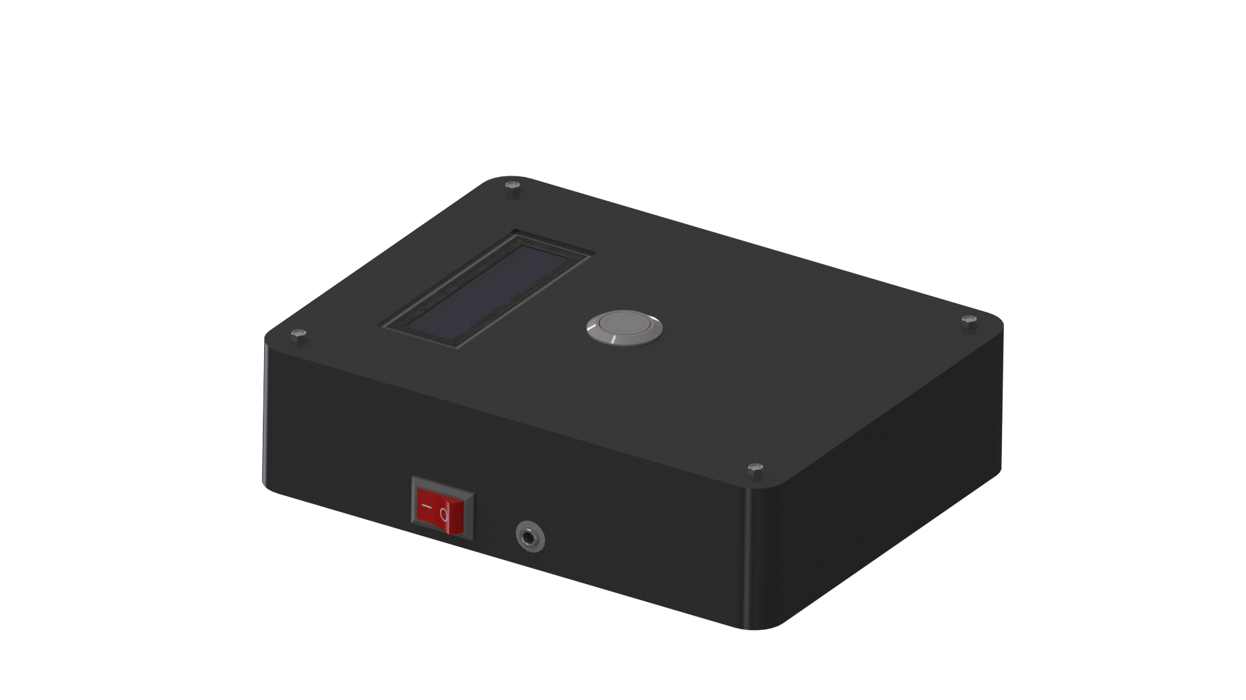
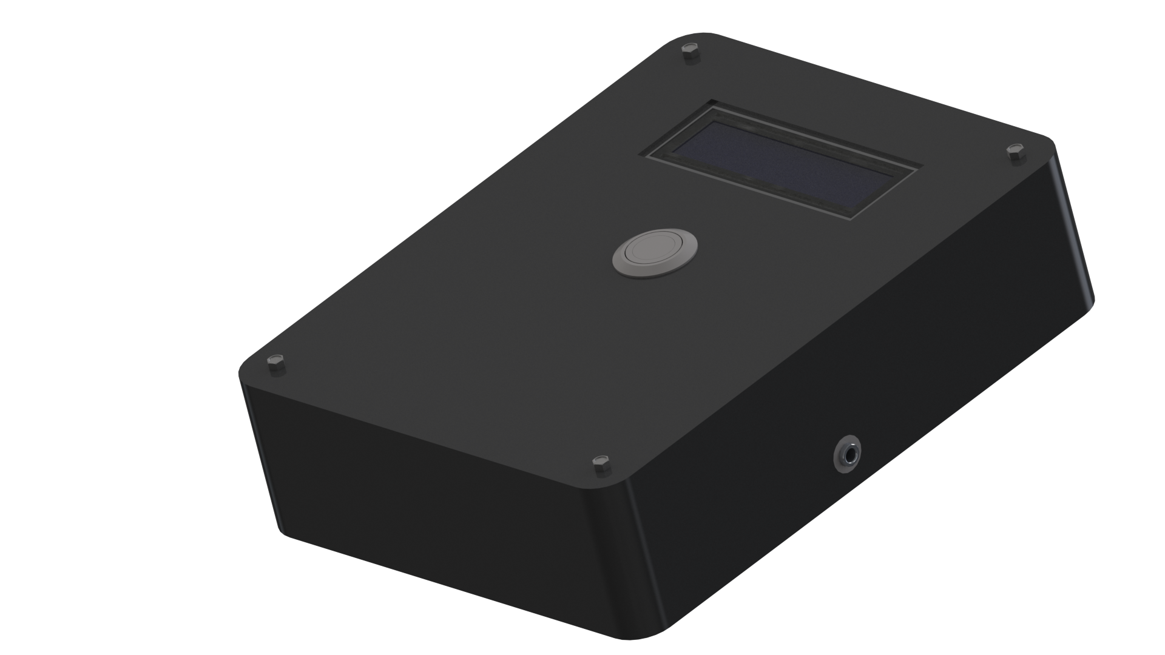
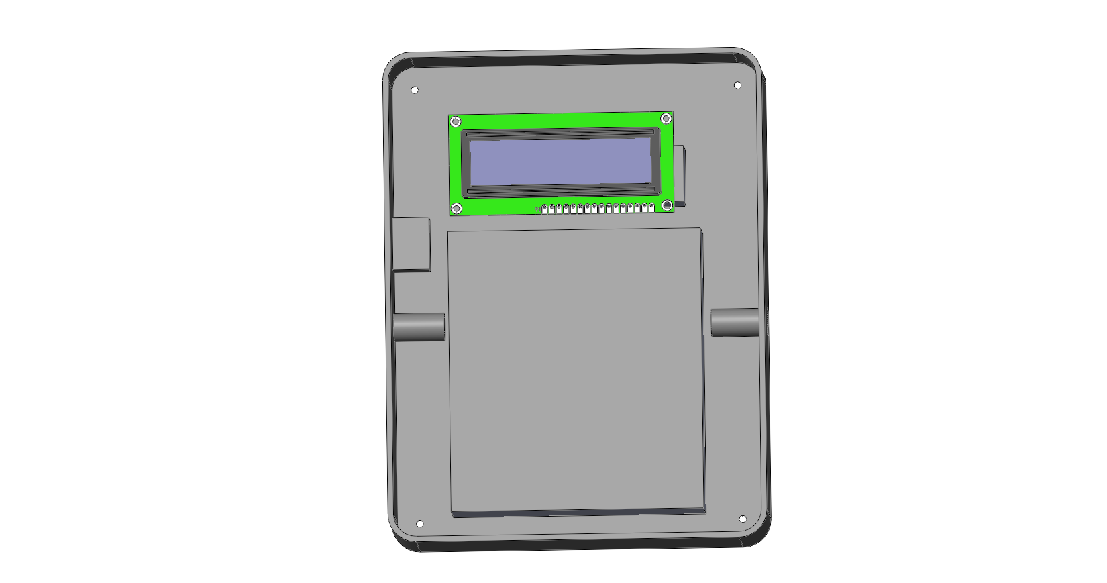
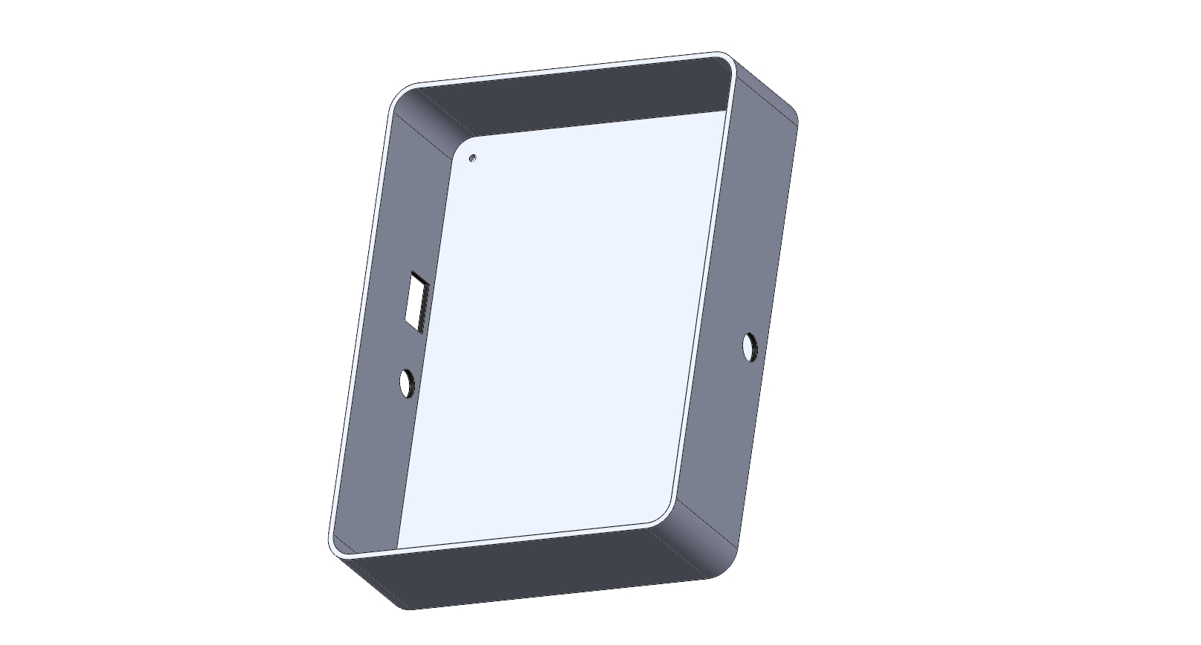
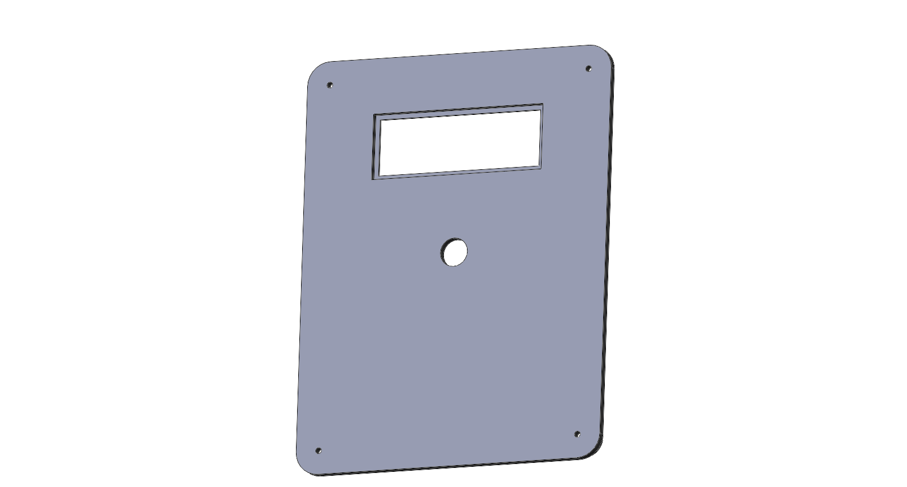
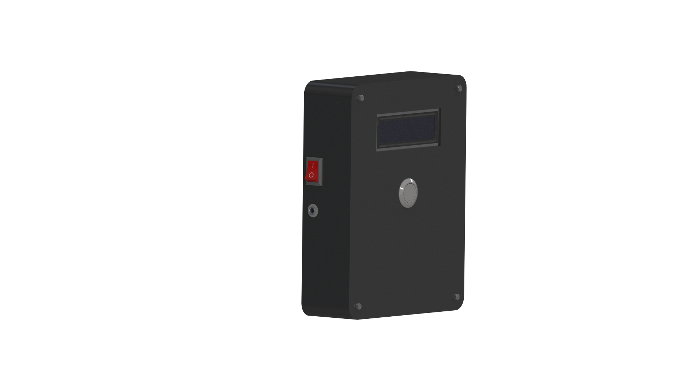
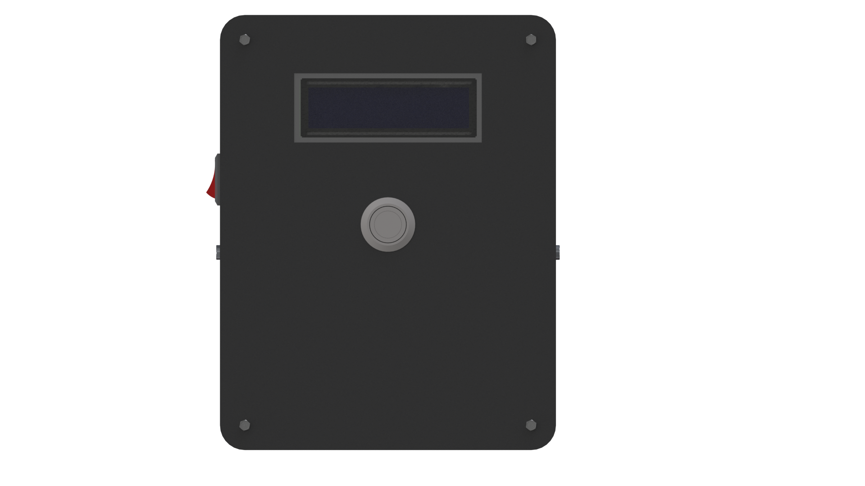
Box
Assembly
Final Render
3D Printing
Cover
Specifications:
• Dimensions: 175mm*135mm*8.5mm
• Thickness: 3.5mm
• LCD dimensions: 71.3mm*26.3mm
• Fillet radius: 10mm
• Waterproof button: 12mm Diameter
• Bolts: M3 screw
3D-Printed parts have many advantages over others. The most important feature for us is that it is completely designed on software and the parts are 100% fit with each other before printing. Also, the clearance can be controlled even if it is 1mm.
Specifications:
• Dimensions: 175mm*135mm*42mm
• Thickness: 2mm
• Fillet radius: 10mm
• 3.5mm female jack: 10mm Diameter
• AC switch: 18.5mm*12mm
• Bolts: M3 screw
It is necessary to ensure that the design is suitable and can accommodate all components of the hardware.
So, before printing our enclosure we prepared the assembly with all components fitted in.
4
3
2
1

Slide 17
5.
Software

Slide 18
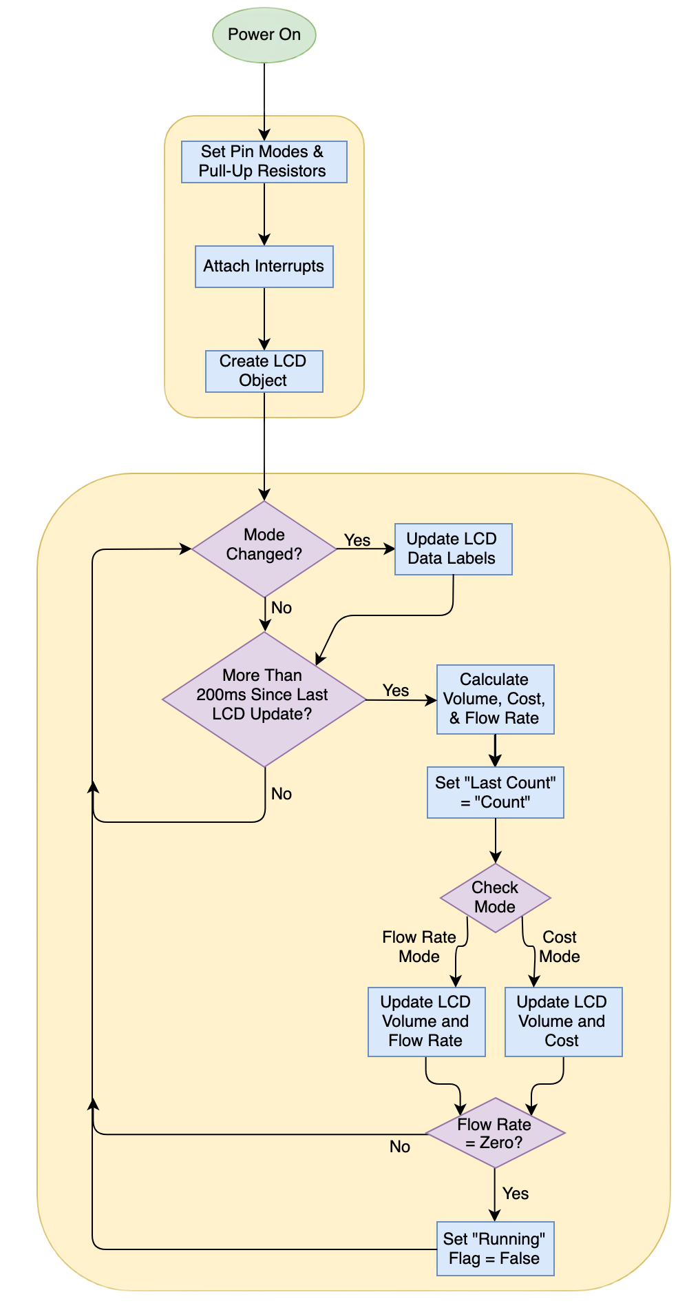

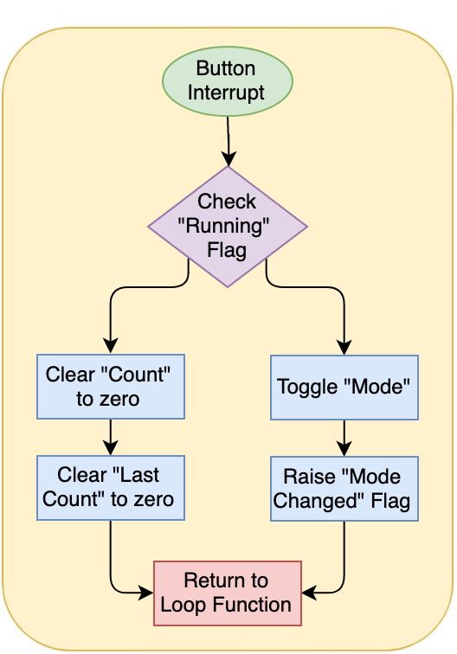
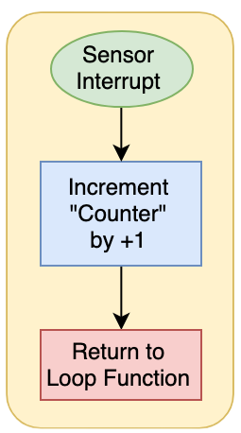
Mind Map

Slide 19

Drivers
CONCEPT
LCD
We have chosen to work with 4-bit data mode. Therefore, we decided to use the first four pins of the LCD from PIN (0) to PIN (3)
Three
Connected to PORTA
CONCEPT
GPIO
Main Drivers
We decided to connect the buzzer to PIN (6) of PORT D as it was simple for us to draw our PCB track without unwanted overlaps.
Main Driver for controlling
The project is divided into (3) layers: App / HAL / MCAL
Buzzer
CONCEPT
Connected to PORTD
Essential driver for deciding the direction of the ports and pins for all external hardware

Slide 20
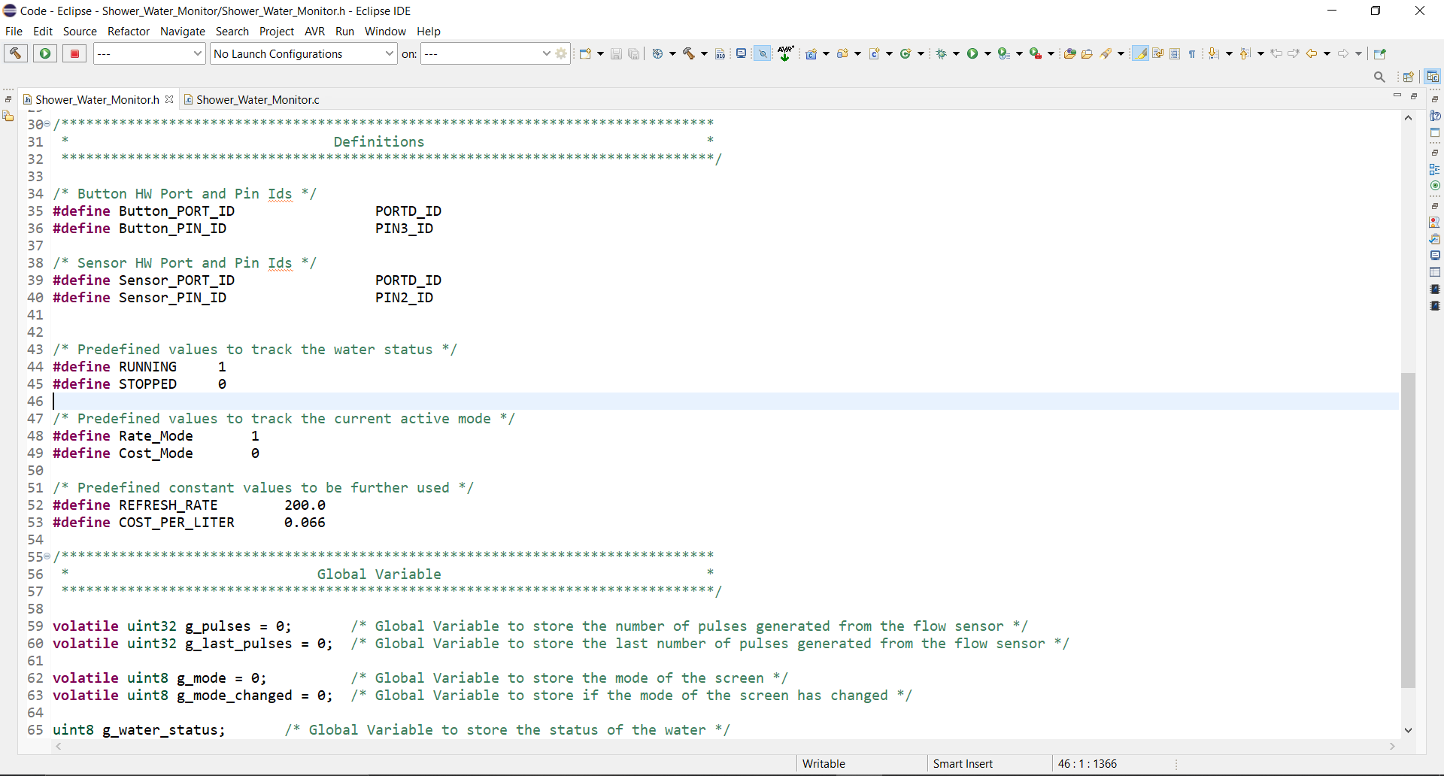

Slide 21
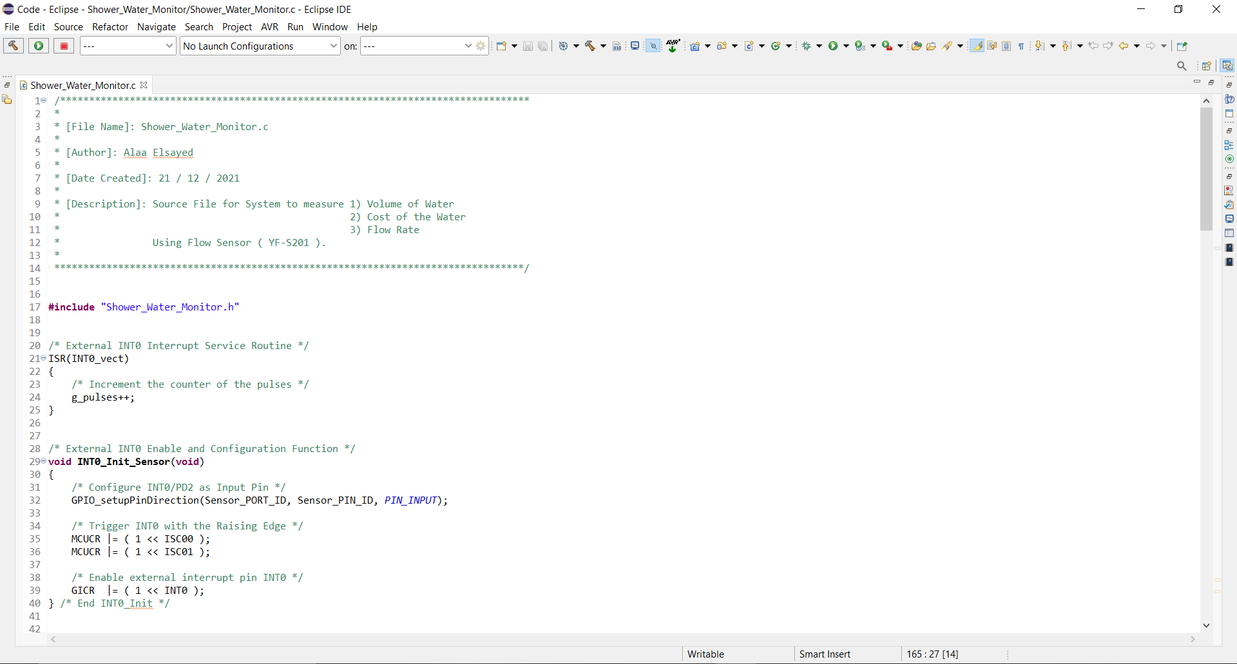

Slide 22
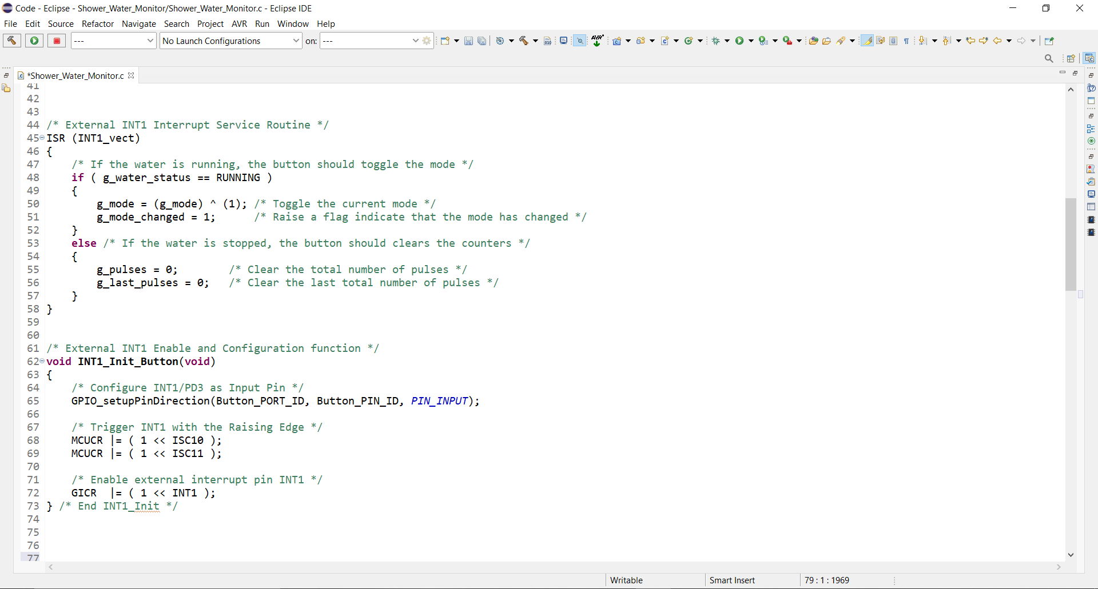

Slide 23
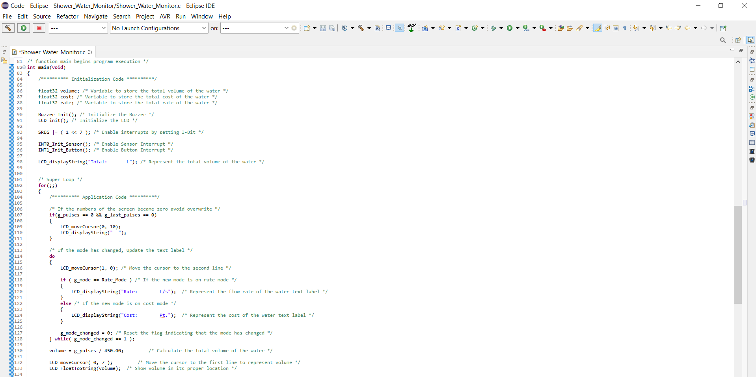

Slide 24
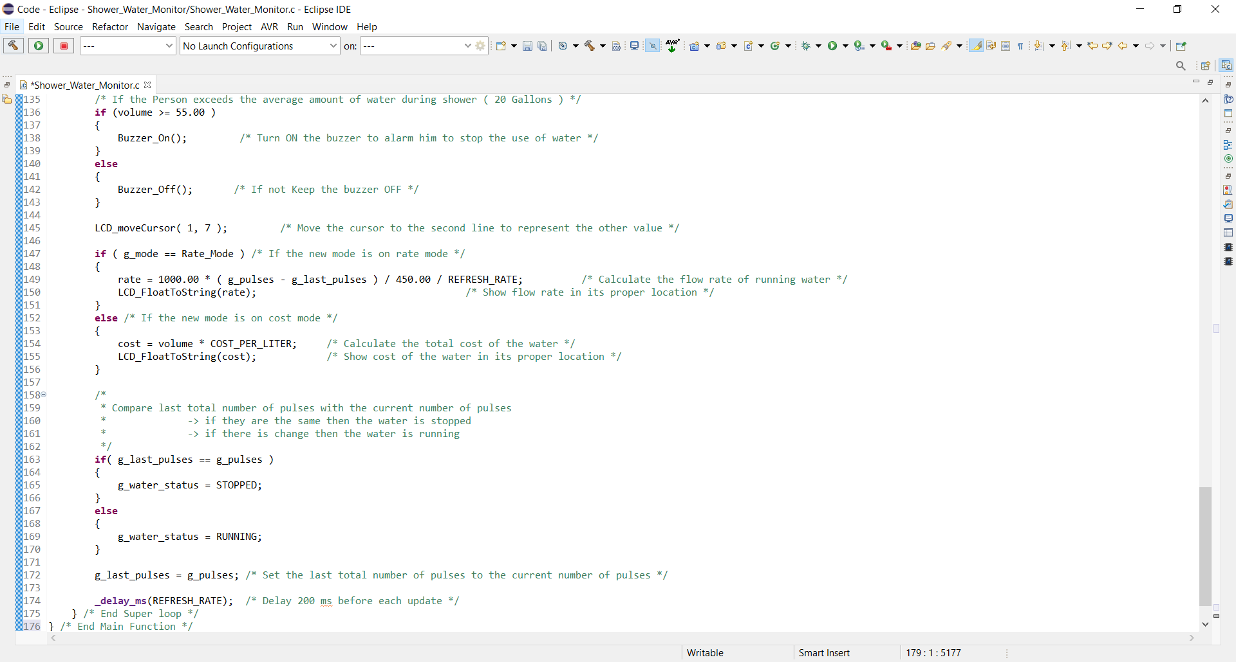

Slide 25
6.
Final
Product

Slide 26
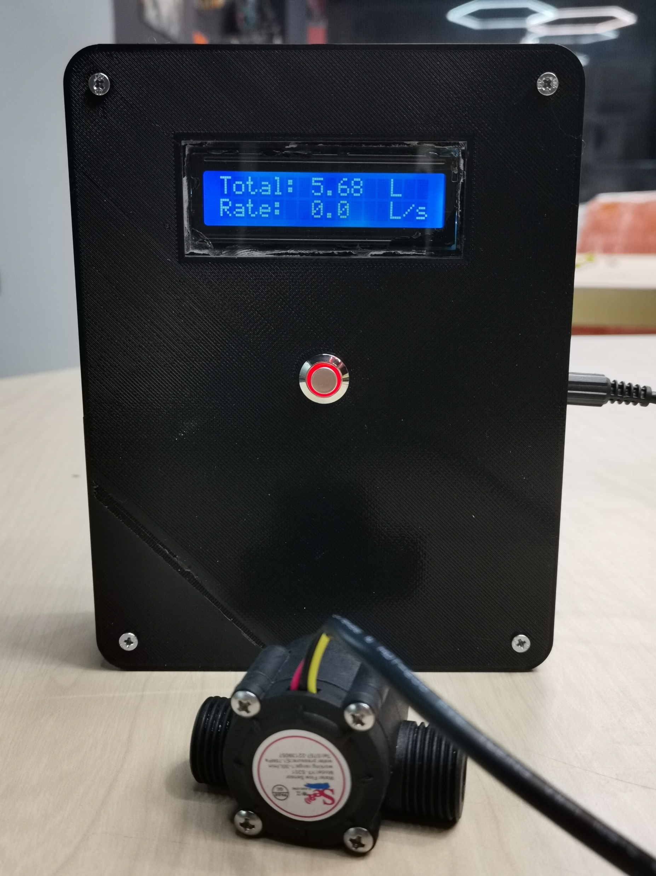

Slide 27

Q&A
alaanasser25@std.mans.edu.eg
ahmedIsmailOsman@std.mans.edu.eg
ahmedelzehery01@std.mans.edu.eg

Slide 28
CREATED BY : ALAA NASSER
THANK YOU

